Slide 1

Design review: System on Chip for Measurement of Physiological Characteristics
CalState Long beach

Slide 2
Blocks designed
Photoplethysmography:
The Photoplethysmography (PPG) sensor is a device commonly found within these "wearable devices" as it offers a compact, non-invasive form factor to monitor the Heart Rate Variability(HRV) of the end user, providing them insight into the health of their heart. In our design a dynamic gain control scheme is proposed to change the gain of the PPG system based on skin pigmentation.
Temperature Sensor:
The Temperature to Frequency sensor is an important block for all "wearable devices“. The temperature is sensed as a voltage proportional to temperature (VPTAT). Voltage signal is converted to current through an amplifier. The mirrored output current charges the capacitor. Based the VPTAT, CT is charged and discharged. Rate of charge and discharge leads to a frequency proportional to temperature

Slide 3
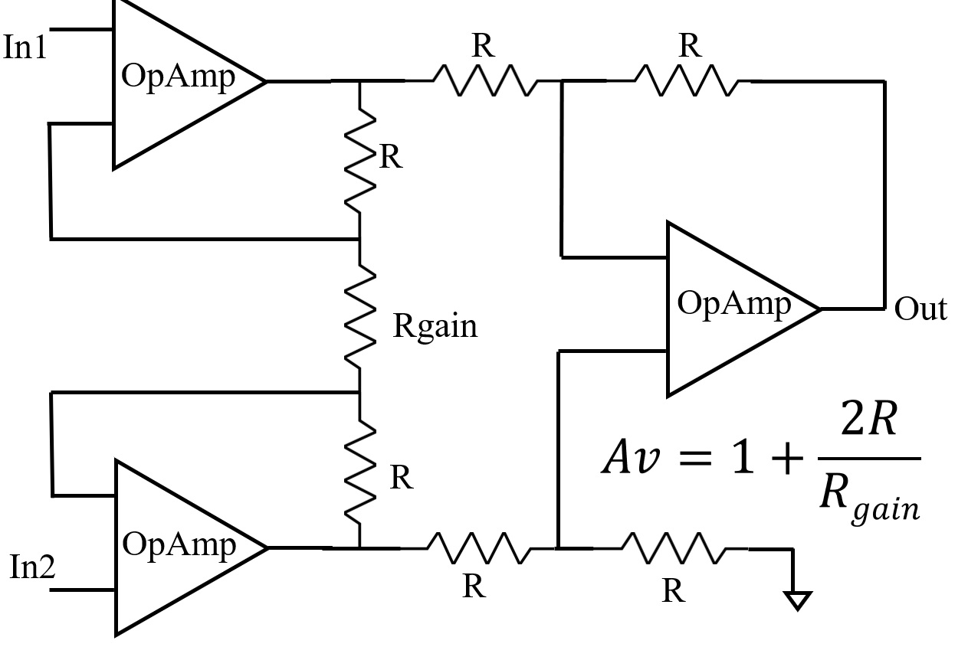
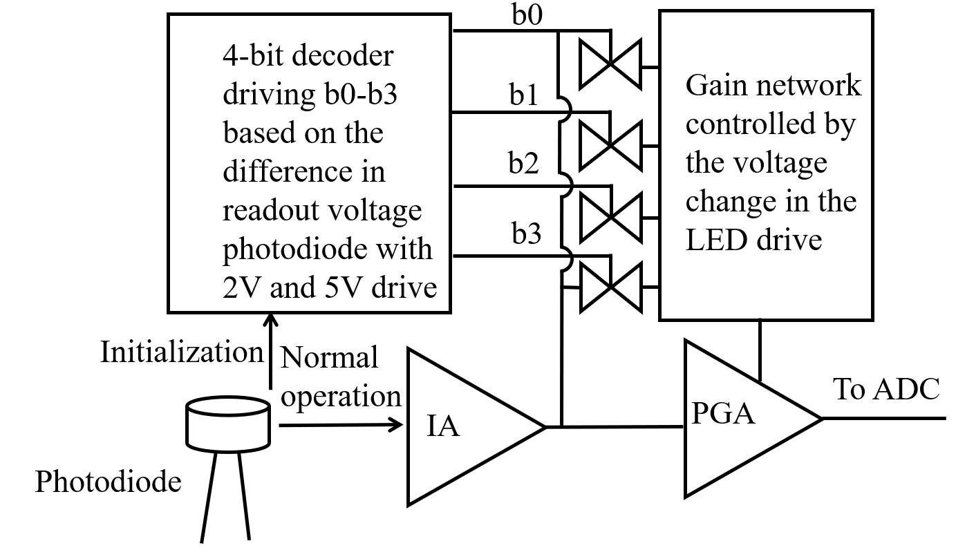
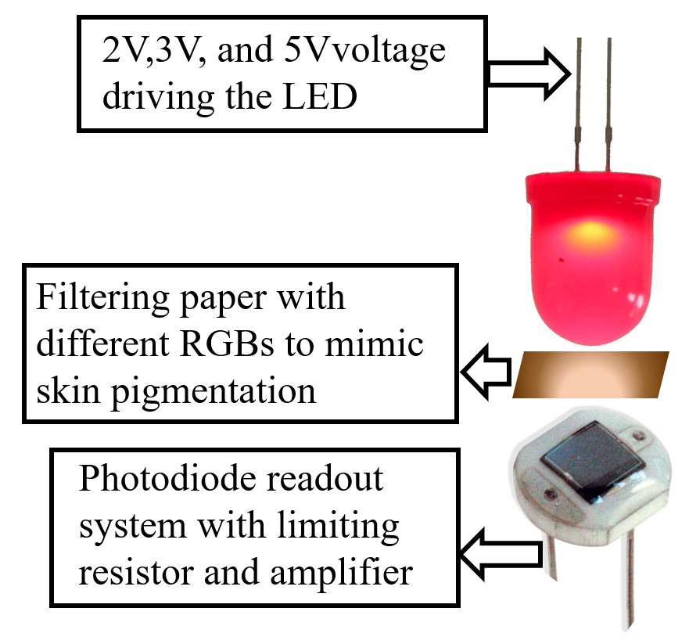
CMOS PPG Sensor with Correcting Feedback for Effects of Skin Pigmentation
Off-chip
Notes:
A photoplethysmogram (PPG) is an optically obtained plethysmogram that can be used to detect blood volume changes in the microvascular bed of tissue.^{[1][2]} A PPG is often obtained by using a pulse oximeter which illuminates the skin and measures changes in light absorption.^{[3]}

Slide 4
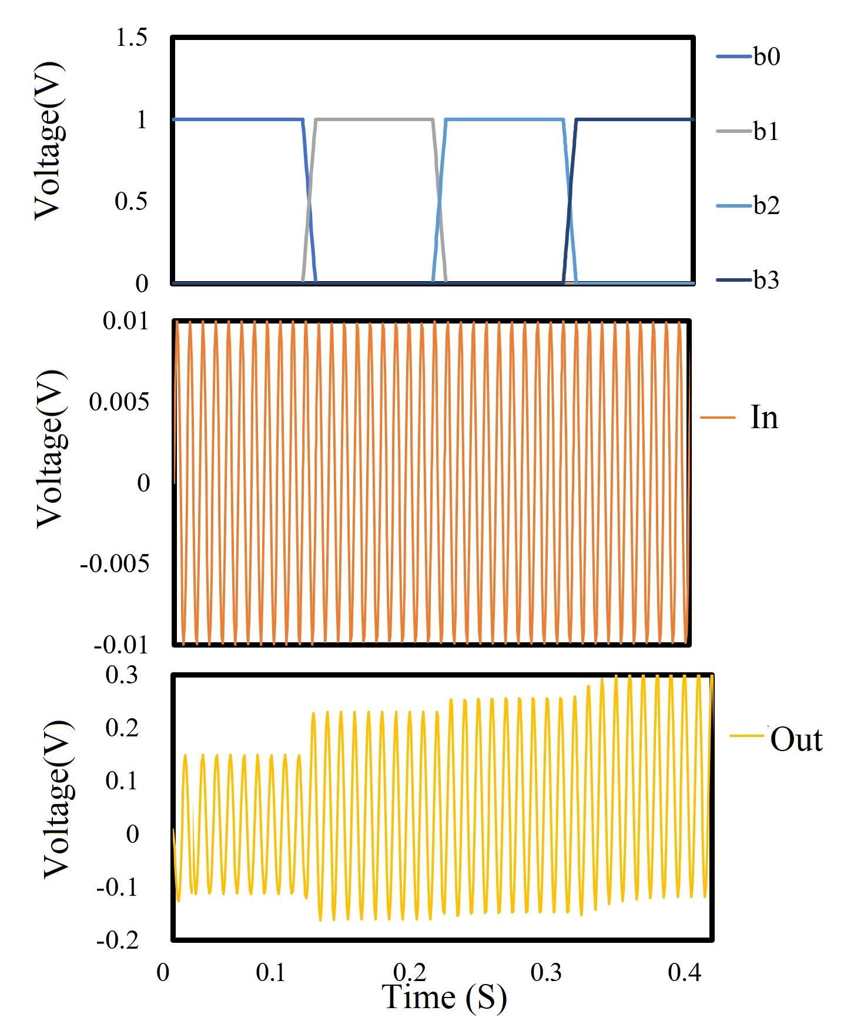
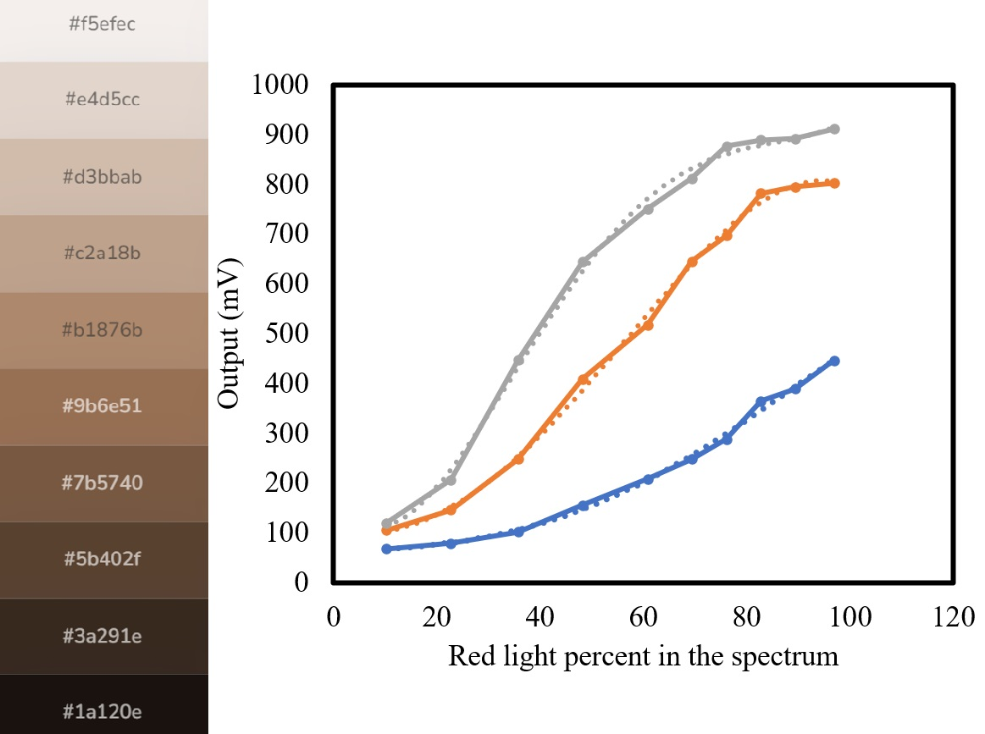
Results
A transient simulation of the PGA, with changing the decoder outputs b0-b3 while reading the output the gain of the amplifier is changed as a response to fewer red pigments.
Red Light Intensity output red from the system Vs. Pigmentation showing a polynomial growth

Slide 5
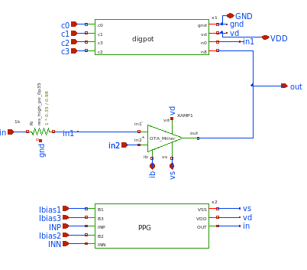
Design in Xscheme
Notes:
A photoplethysmogram (PPG) is an optically obtained plethysmogram that can be used to detect blood volume changes in the microvascular bed of tissue.^{[1][2]} A PPG is often obtained by using a pulse oximeter which illuminates the skin and measures changes in light absorption.^{[3]}

Slide 6
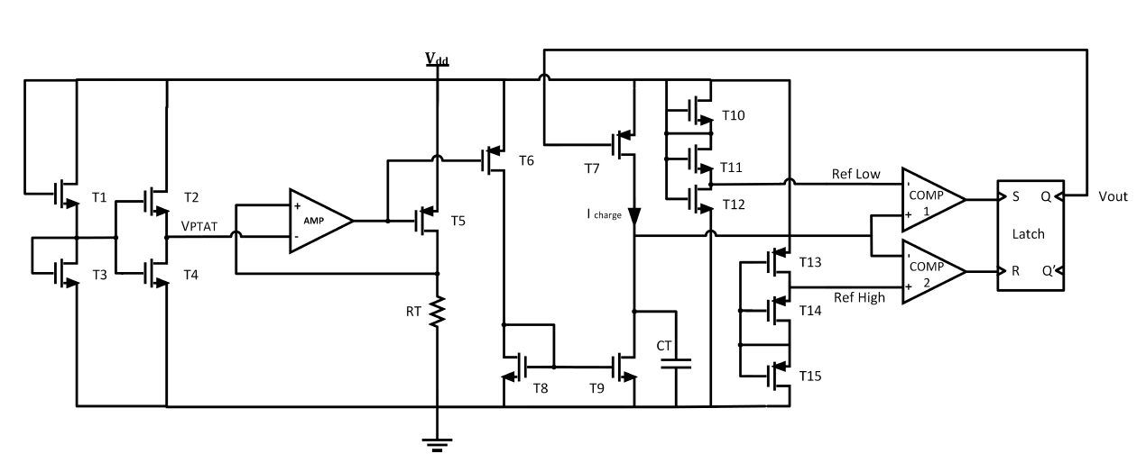
Temperature to frequency sensor
The temperature sensing core is constructed using serially connected MOS transistors to generate the proportional to absolute temperature (VPTAT ). The PTAT signal is converted to current through an amplifier and a scaling
transistor.

Slide 7
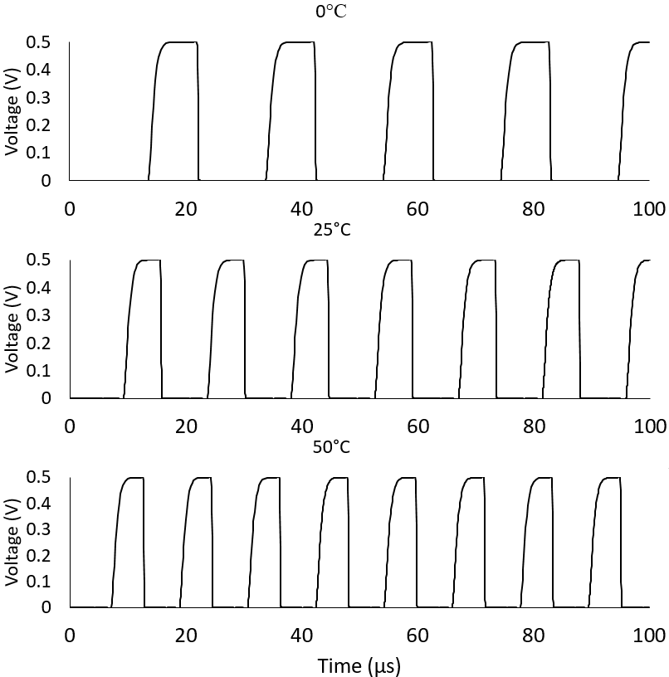
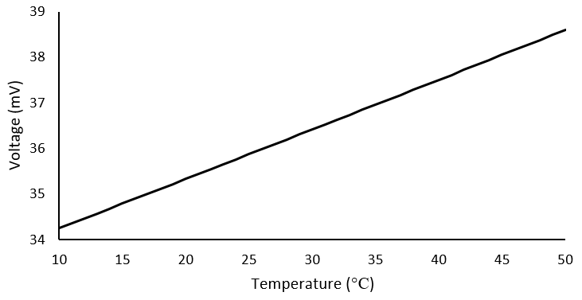
Results

Slide 8
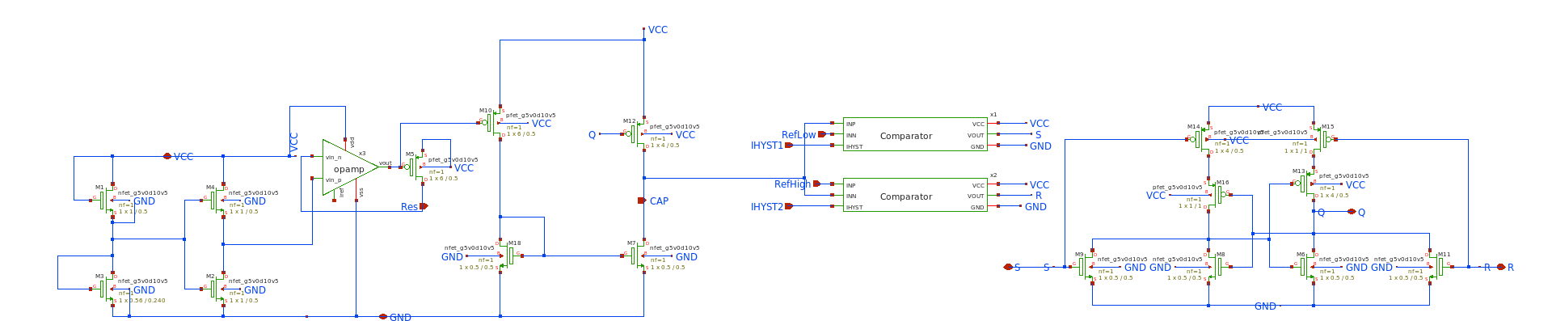
Design in Xscheme

Slide 9
Thank you!

